Slide 1
Unit 3 – Planning and management of IT projects

Slide 2
Topics covered so far…
IT projects…why they happen
“…employing technology solution to bring about measurable improvements to a system”
Drivers … the factors which create an impetus for this to happen (e.g. reduce costs, make money etc)
Project management concepts
Plan, organise, budget and control the project so that customer needs are met within the constraints given
Q: Why do projects fail?

Slide 3
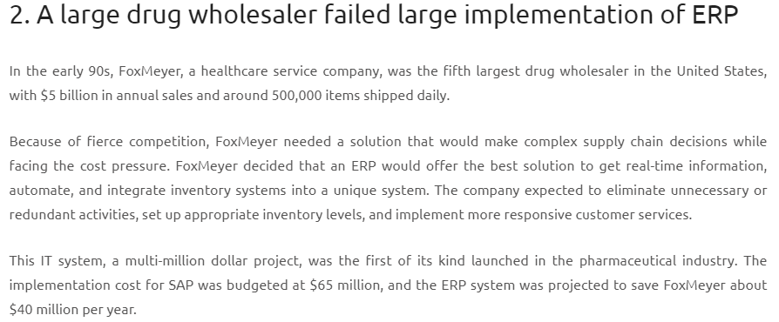
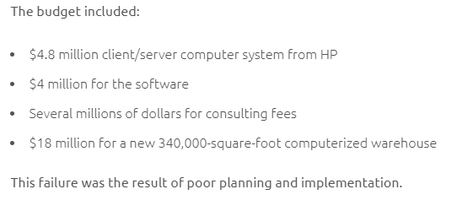

Slide 4
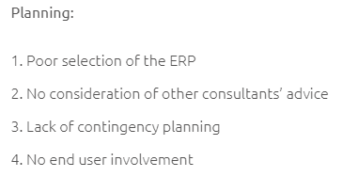
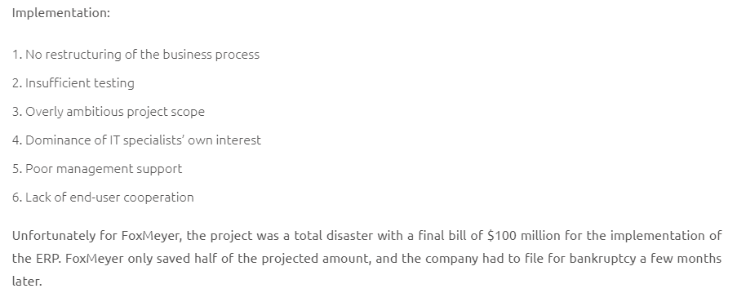
Points to focus on:
‘contingencies’ (financial, time related)
‘end user involvement’
‘testing’
‘end user co-operation’ at planning and implementation stages

Slide 5
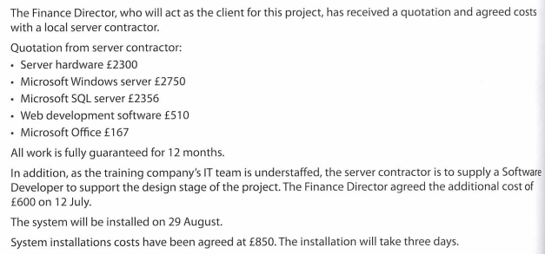
Budgets (your scenario will include information like this)

Slide 6
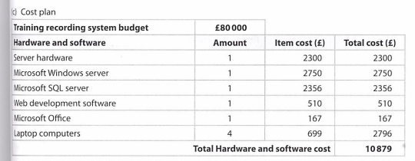

Slide 7
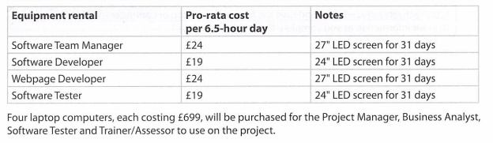
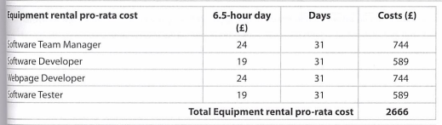

Slide 8
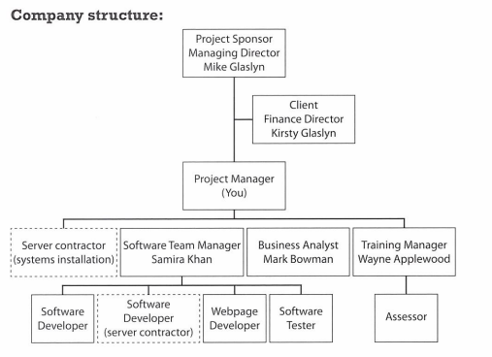
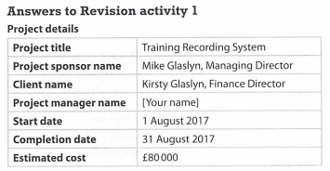

Slide 9
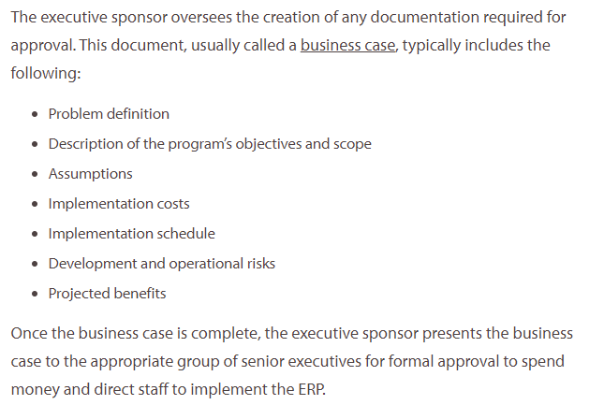
The ‘business case’

Slide 10
Task
Get a copy of the Project Initiation Document from the exam docs folder on shared area
Read the ‘business case’
Locate the section SMART targets section. You should be able to add 9 SMART targets into the table from the ‘business case’ section of the PID

